Slide 1
UI AND UX
SOBIN IMAN RAJ
BSC AI AND ML

Slide 2
What is UI ?
User interface
DEFINITION:
It is the visual part of an application or website
It includes buttons icons colors, fonts ,menu, and layouts
good UI makes an application attractive and easy to use
EXAMPLE:
The buttons icons and screens in a mobile app

Slide 3
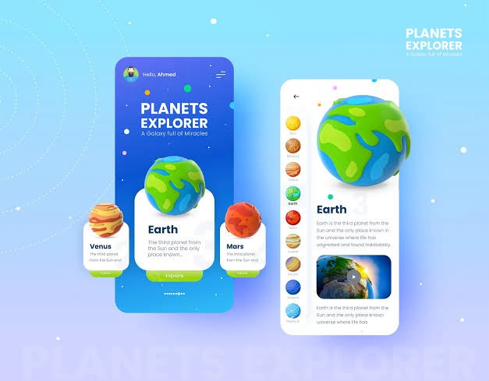
UI image :

Slide 4
What is UX?
User Experience
DEFINITION:
.It describes how a user feels while using a product
.UX focuses on ease of use satisfaction and efficiency
.good UX helps users complete tasks easily
EXAMPLE:
.easy navigation
.smooth ordering
.delivery app

Slide 5

UX image

Slide 6
Difference Between UI AND UX
UI UX
.Tabs .search google or type
.Address . AI mode
.Forward buttons .Your browsing history
.Refresh buttons .website you visit
.bookmarks .Password and autofill assistance

Slide 7
UI AND UX IMAGE:

Slide 8
UI AND UX CONCEPT:
. UI and UX work together to create better a digital product
. UI focuses on how the product looks
. UX focuses on how the product works and feels
.Good UI AND UX Better Experience

Slide 9
Thank You!
INTRODUCTION TO UI AND UX

